Slide 1
Front End Engineering-I Project
Team Details:
Name Roll no.
Pratistha Negi 2210990678
Pratyukt Nag 2210990679
Prerna Dua 2210990680
Prianshu Kumar 2210990681
Faculty Coordinator: Dr Mandeep Kaur
:
Chitkara University Institute of Engineering and Technology,
Chitkara University, Punjab

Slide 2
Table of Contents
Introduction
Problem Statement
Technical Details
Key Features
Project Highlights
Conclusion
References/Links used

Slide 3
Introduction
Title: Google Search Engine
Team Members: Pratistha Negi, Pratyukt Nag, Prerna Dua, Prianshu Kumar
Overview: Google is a fully-automated search engine that uses software known as "web crawlers" that explore the web on a regular basis to find sites to add to our index.
Goals:
Google Search is a popular search engine that enables users to search for a wide range of information on the internet.
Google Search quickly gained popularity and became the world's most widely used search engine.
Google uses a complex algorithm that analyzes millions of websites to provide relevant search results to users.
The algorithm takes into account a variety of factors such as the relevance and quality of the content, the popularity of the website, and the user's search history and location.

Slide 4
Introduction
Google Search provides a variety of tools and features to help users refine their search results. For example, users can use advanced search operators to specify their search terms and filter results by date, location, or file type. Google also provides related search suggestions and autocomplete suggestions to help users find what they're looking for faster.
In addition to its search engine, Google offers a range of other products and services, including Gmail, Google Maps, Google Drive, and Google Calendar. These products are integrated into Google Search, allowing users to easily access and use them while searching for information on the internet.

Slide 5
Problem Statement
Before the advent of search engines like Google, finding information on the internet was a time-consuming and challenging task. Early search engines relied on a simple keyword-based approach, which often resulted in irrelevant or low-quality search results.
Google Search aimed to solve this problem by using a more sophisticated algorithm that analyzes the content and context of web pages to provide more relevant search results.
Google's approach to search proved highly effective, and the company quickly became the dominant search engine on the internet. Today, Google processes billions of search queries every day, and its algorithm has evolved to incorporate a wide range of factors such as user location, search history, and content relevance.
Overall, Google Search has helped to democratize access to information on the internet by making it easier for people to find what they're looking for quickly and efficiently. This has had a significant impact on the way we consume and share information, and has played a key role in the growth of the digital economy.

Slide 6
Technical Details
The Front-End technologies that are used to implement this project are:
Html- The Hypertext Markup Language or HTML is standard markup language for documents designed to be displayed in a web browser.
Uses of html in project:
<html> represents the root of an HTML document.
<head> represents a collection of metadata for doc.
<meta> represents various kinds of metadata that can’t be expressed using title, base, link, style.
<title> represents document’s title or name
<link> allows authors to link their documents to other resources.
<body> represents contents of the documents.
<h1> represents a section heading.
8. <style> allows for quick styling using CSS
9. <div> element is the generic container for flow content
10. <ul> represents unordered list.

Slide 7
Technical Details
2. CSS- CSS or cascading style sheets is used for styling and formatting HTML documents. It is used to define styles for HTML elements such as fonts, colors, spacing and layout.
Uses of CSS in project:
External css has been used to give a proper layout to our website.
In adjustment of size and margin of images used using background-size, overflow, height, width, background-size , background-position, margin and more.
created an add bar and designed it in such a way that we are able to add our day to day task and also we created an add button using div in html.
Horizontal bar containing All, Completed and Not Completed tasks and used different.
3.Java script- JavaScript is a programming language used to add interactivity and functionality to websites. It is commonly used to create dynamic effects, responsive and interactive web pages.

Slide 8
Key Features
User Friendly Interface: A visually appealing and easy to use interface that allows user of different age groups to acess the google search .
Search operators: Google Search provides a range of search operators that enable users to refine their search results by specifying search terms, filtering by date, location, or file type, and more.
Featured snippets: Google Search displays featured snippets at the top of some search results, providing users with a quick and concise answer to their query.
Image search: Google Search enables users to search for images on the internet, filtering by size, color, and other criteria.
Personalized search: Google Search uses a user's search history and location to provide personalized search results, tailored to their interests and needs.

Slide 9
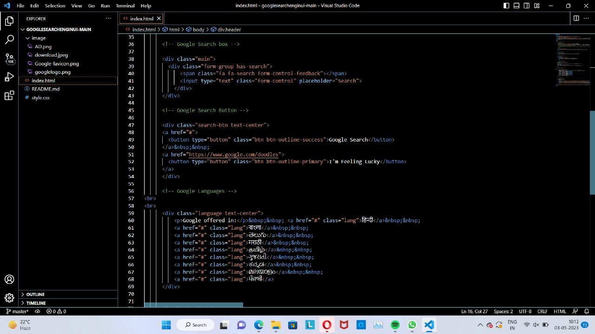
Project Highlights
The project that we created is a google search engine using HTML, CSS, and JavaScript. Our goal was to create an intuitive and visually appealing platform for users to search various things on web.
To achieve this, we designed the user interface with a white background and black text, giving it a modern and minimalist look. We added a touch of turquoise color to the buttons to provide a contrasting and visually pleasing experience.

Slide 10
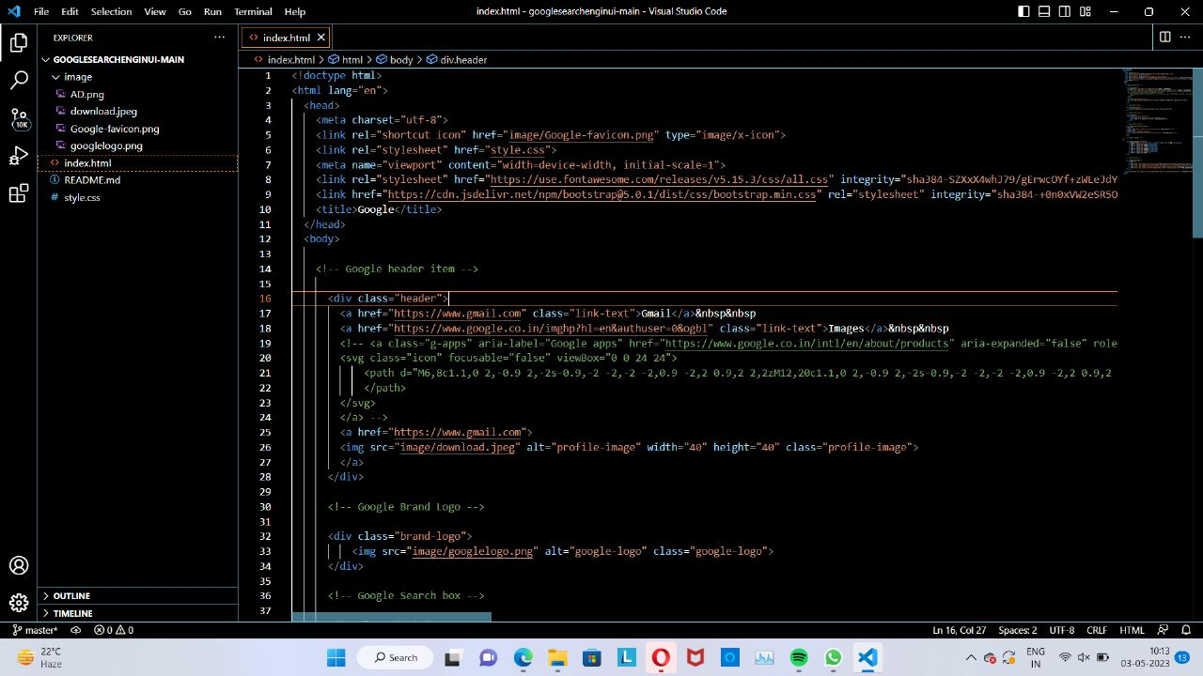
Project Highlights
In the project, we made some
design changes to the google search engine buttons to enhance the overall user experience. We used a touch of turquoise color for the buttons to provide a contrasting and visually pleasing experience.
The buttons are designed with a modern and minimalist look that blends well with the white background and black text of the
user interface.

Slide 12
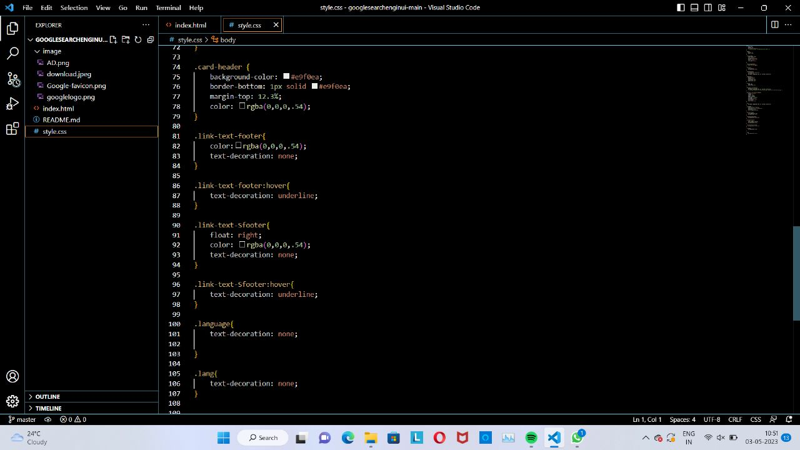
Project Highlights
As mentioned earlier, we made some design changes to the buttons in the search engine to enhance the overall user experience. One of the changes we made was to add a bit of shadow to the buttons using CSS.

Slide 13
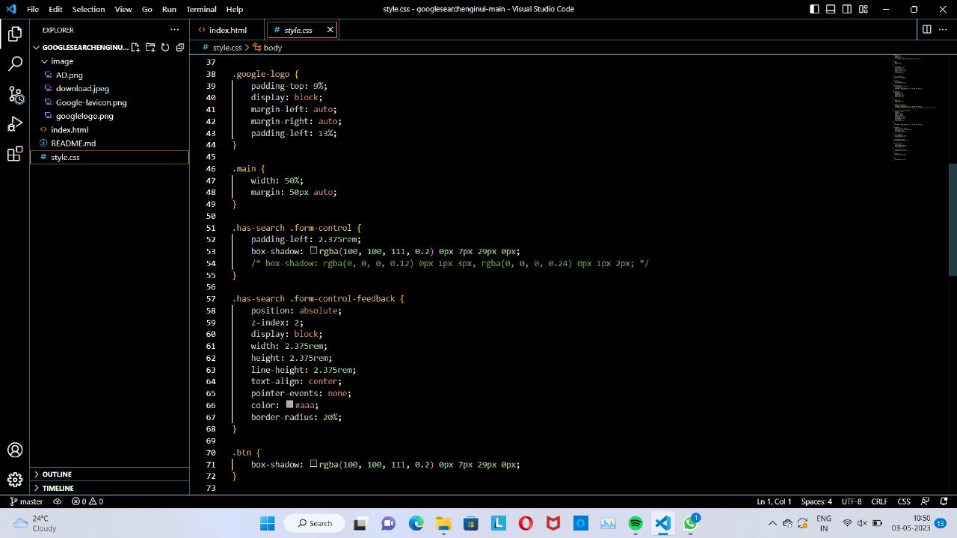

Slide 14
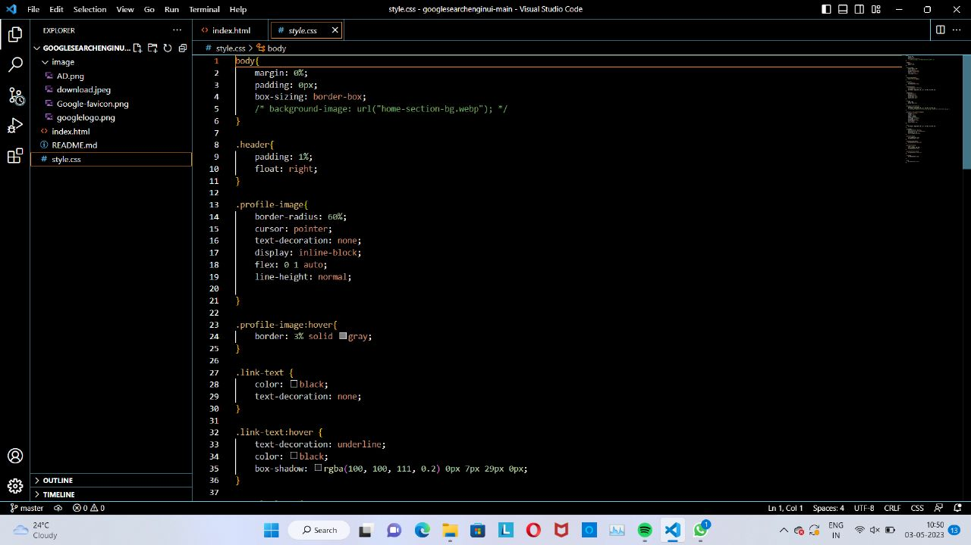
Project Highlights
We used the box-shadow property in CSS to add a subtle shadow effect to the buttons, which gives them a three-dimensional appearance and makes them stand out more.
Additionally, we added a border to the buttons using the border property, which helps to define their edges and add structure to the overall design.

Slide 15
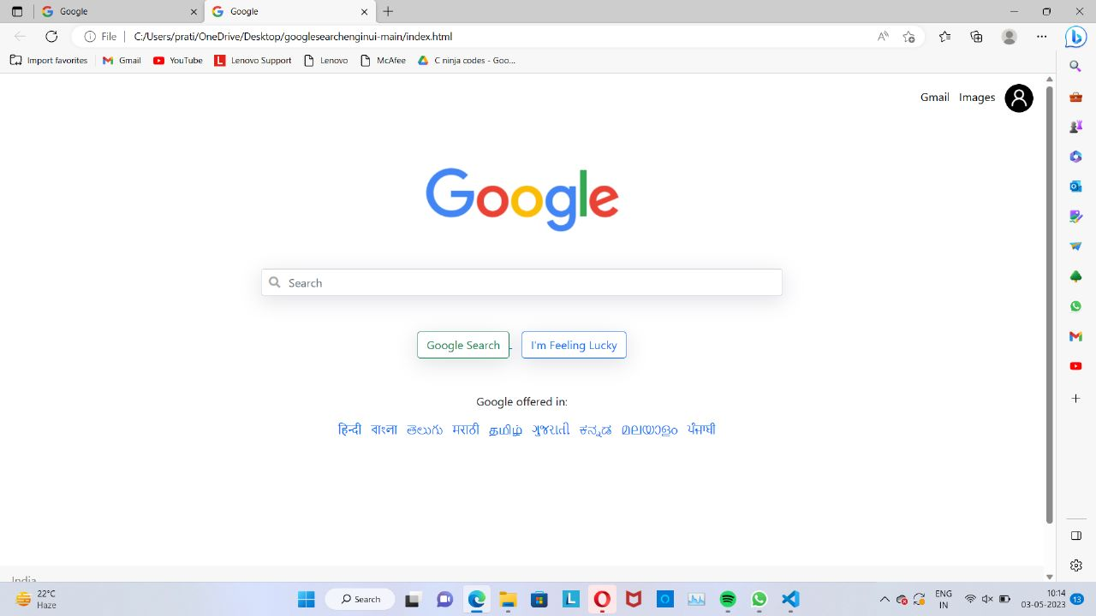
Project Highlights
.

Slide 16
Conclusion
User Friendly Interface: A visually appealing and easy to use interface that allows user of different age groups to acess the google search .
Search operators: Google Search provides a range of search operators that enable users to refine their search results by specifying search terms, filtering by date, location, or file type, and more.
Featured snippets: Google Search displays featured snippets at the top of some search results, providing users with a quick and concise answer to their query.
Image search: Google Search enables users to search for images on the internet, filtering by size, color, and other criteria.
Personalized search: Google Search uses a user's search history and location to provide personalized search results, tailored to their interests and needs.

Slide 17
References/Links used
Sources and References:
In developing our google search Engine project , we refered several source and tools.
These include:
HTML and CSS Tutorials (W3Schools): W3Schools is a popular online learning platform that offers a variety of tutorials and resources for learning HTML, CSS, and other web development technologies.
Stack Overflow (https://stackoverflow.com/): A popular online community for programmers to ask and answer technical questions related to programming.

Slide 18


